Slide 1
Dolutegravir and the universal antiretroviral regimen: good may be the enemy of perfect
Reuben Granich, MD, MPH
Public Health Consultant
Geneva, Switzerland
Somya Gupta, MA
Public Health Consultant
Delhi, India

Slide 2
Introduction
Background
TLD as universal regimen
Safety signal
Conclusion

Slide 3


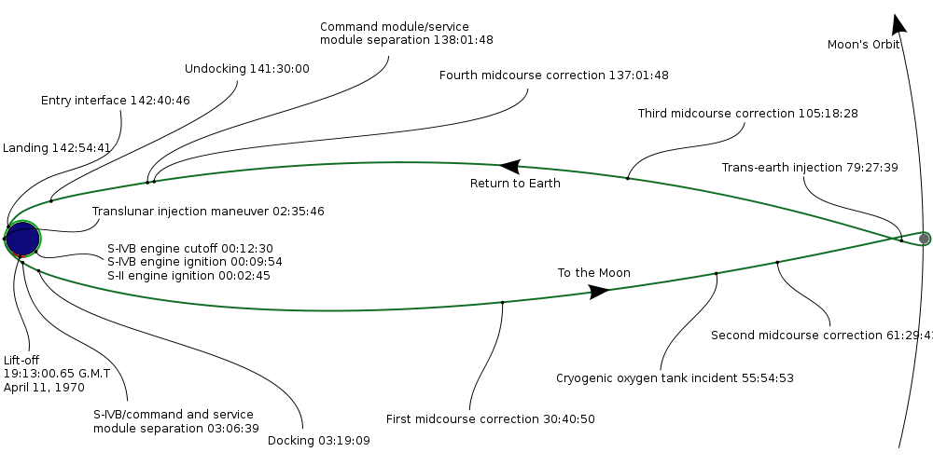
Apollo 13 strategy:
“Working the Ending AIDS problem”
Set clear and shared goals
United leadership on goals, priorities, execution, and accountability
Change business as usual
Establish accountability and use open data principles
Accelerate translation of science to service delivery
Budget for success
Failure is not an option!

Slide 4
End of AIDS: “Big Five” Major Innovations
End of AIDS
HIV self-testing
Cohort and Unique Identifier
Unified leadership around 90-90-90
Universal regimen (TLD)
Multi-disease prevention campaign
Notes:
Here we see a few innovations that have the potential to disrupt the current response. These are all backed by papers, studies, and implementation experience.
HIV self-testing is already “democratizing” or lowering barriers to HIV diagnosis. Test costs have come down in price and are being made available in both the private and public sector. The costs of the tests, assuming that they bring in new diagnoses, are minimal considering the cost savings of diagnosing HIV earlier.
Cohorts and unique identifiers have been around for a while and are commonly used for other diseases such as tuberculosis. Some HV programs have used these simple forms of M and E to measure program and individual progress. Cohorts coupled with unique identifiers allow the program to do both cross sectional cascade analyses but to also understand whether the program is improving over time.
Leadership around 90-90-90 and 95-95-95 is solidifying and the international agencies, MoH and community are in agreement that accessing treatment is essential. As leadership comes together then rapid action on strategy, policies and implementation around 90-90-90 and 95-95-95 will become increasingly the norm.
TLD—Tenofovir, lamuvidine, and dolutegrivir regimen has the promise to become the new universal regimen. This regimen has a number of benefits including lower costs, lower service delivery costs, lower side effects profile, lower risk of resistance, and a simplified supply chain (fewer ARVs on the formulary simplifies procurement and lowers costs).
Multi-disease prevention campaign uses multiple health interventions over a short time frame to achieve multiple public health objectives. In Kenya in 2008 a campaign distributed water filters, insecticide treated bed nets, and HIV testing reached over 40,000 people in 7 days including over 20,000 men. Using a broad non-HIV focused campaign is an innovation that reaches people earlier and without the potential stigma of a HIV-specific campaign.

Slide 5
90-90-90 and Continuum of Care Targets
90%
90%
90%
Know status
On treatment
Virally suppressed
90%
81%
73%

Slide 6
95-95-95 and Continuum of Care Targets
95%
95%
95%
Know status
On treatment
Virally suppressed
95%
90%
86%

Slide 7
Global access to HIV treatment, 2010-2017
81%
Treatment gap
60%
On ART

Slide 8
ART Eligibility Criteria (129 countries)
<200, <250 or <300
<350
<500
>500
Treat all in 62 countries (~86% burden)
Irrespective of CD4 count
Last updated: January 2018

Slide 9
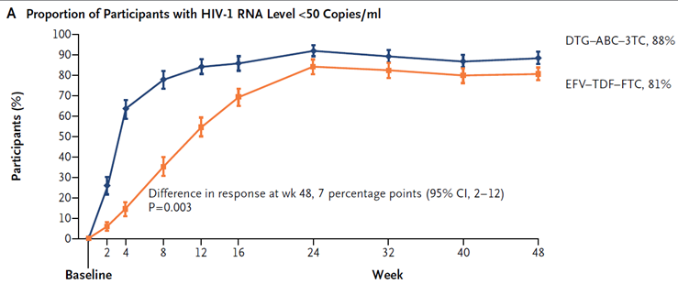
Science supports Dolutegravir
Virological response
Response in TB patients
Virologic Outcome at Wk 24, n (%) | DTG + 2 NRTIs (n = 69) | EFV + 2 NRTIs (n = 44)
HIV-1 RNA < 50 copies/mL | 56 (81) | 39 (89)
HIV-1 RNA ≥ 50 copies/mL | 7 (10) | 3 (7)
No virologic data | 6 (9) | 2 (5)
Dooley KE, et al. CROI 2018. Abstract 33.
Walmsley et al, Dolutegravir plus Abacavir–Lamivudine for the Treatment of HIV-1 Infection, NEJM 2013
Adverse events
Pregnancy outcomes: Tsepamo Botswana
Adverse Events (AE) from ARIA | DTG/ABC/3TC (n = 248) | ATV + RTV + TDF/FTC (n = 247)
Discontinuations due to AE | 4 | 7
Serious AE | 5 | 8
Fatal AE | < 1* | 0
Drug-related serious AE | 0 | 1
Any AE | 79 | 80
Grade 2-4 AE | 46 | 55
Orrell C, et al. AIDS 2016. Abstract THAB0205LB

Slide 10
Projected PEPFAR cost savings (2018-2020):
TLE ($79 per year) vs TLD ($75 per year)
Country | Person Years ART 2018-2020 | Cost Savings 2020 | Cost savings 2018-2020
Botswana | 645,174 | 860,232 | 2,580,696
Cote d'Ivoire | 1,065,063 | 1,773,488 | 4,260,252
Ethiopia | 1,943,348 | 3,235,792 | 7,773,392
Haiti | 322,572 | 430,096 | 1,290,288
Kenya | 4,043,551 | 5,644,336 | 16,174,204
Lesotho | 823,931 | 1,225,388 | 3,295,724
Malawi | 2,628,856 | 4,023,904 | 10,515,424
Mozambique | 4,183,034 | 6,314,880 | 16,732,136
Namibia | 611,562 | 902,380 | 2,446,248
Rwanda | 364,056 | 571,584 | 1,456,224
South Africa | 13,113,057 | 17,484,076 | 52,452,228
Swaziland | 589,147 | 862,296 | 2,356,588
Tanzania | 3,847,812 | 5,579,460 | 15,391,248
Uganda | 3,849,860 | 5,835,604 | 15,399,440
Zambia | 2,997,856 | 4,427,500 | 11,991,424
Zimbabwe | 2,952,387 | 3,936,516 | 11,809,548
Total | 43,981,266 | $63,107,532 | $175,925,064

Slide 11
Cost savings beyond ARVs
Simplified supply chain
Simplified high quality service delivery
Reduced costs of illness
Reduced costs of death
Reduced costs of transmission
Prevention of drug resistance (incalculable)

Slide 12
Good is enemy of nearly perfect:
 | TLE | TLD
Efficacy |  | X
Tolerability |  | X
Time to suppression |  | X
Higher barrier to resistance |  | X
Address pre-treatment NNRTI resistance |  | X
Improve community demand |  | X
Reduce costs |  | X
Simplified service delivery |  | X
North South access equity |  | X
Safety in pregnancy | x

Slide 13
Forecast of TLD Manufacture Capacity
Oct, 2017-March, 2019

Slide 14
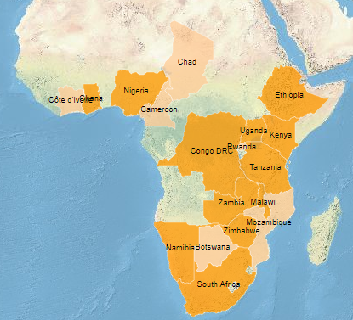
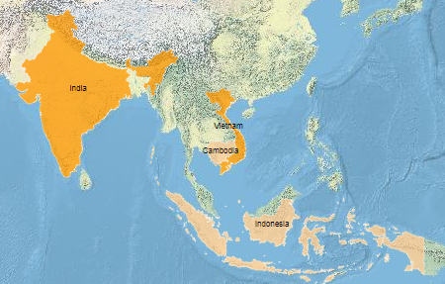
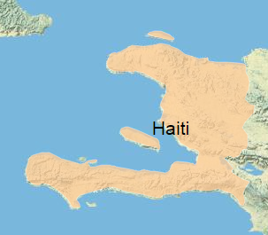
TLD Country Registration Update, As of August 29, 2017
Country | Most advance filing status
Kenya | Filed
Tanzania | Filed
Botswana | Filed
Congo DRC | Filed
Ethiopia | Filed
Ghana | Filed
India | Filed
Malawi | Filed
Namibia | Filed
Nigeria | Filed
South Africa | Filed
Uganda | Filed
Vietnam | Filed
Zambia | Filed
Zimbabwe | Filed
Cambodia | Q3-17
Cameroon | Q3-17
Chad | Q3-17
Côte d'Ivoire | Q3-17
Haiti | Q3-17
Indonesia | Q3-17
Mozambique | Q3-17
Mynmar | Q3-17
Rwanda | Q3-17
Filed
Will file by Q3-17
Slide courtesy PEPFAR

Slide 15
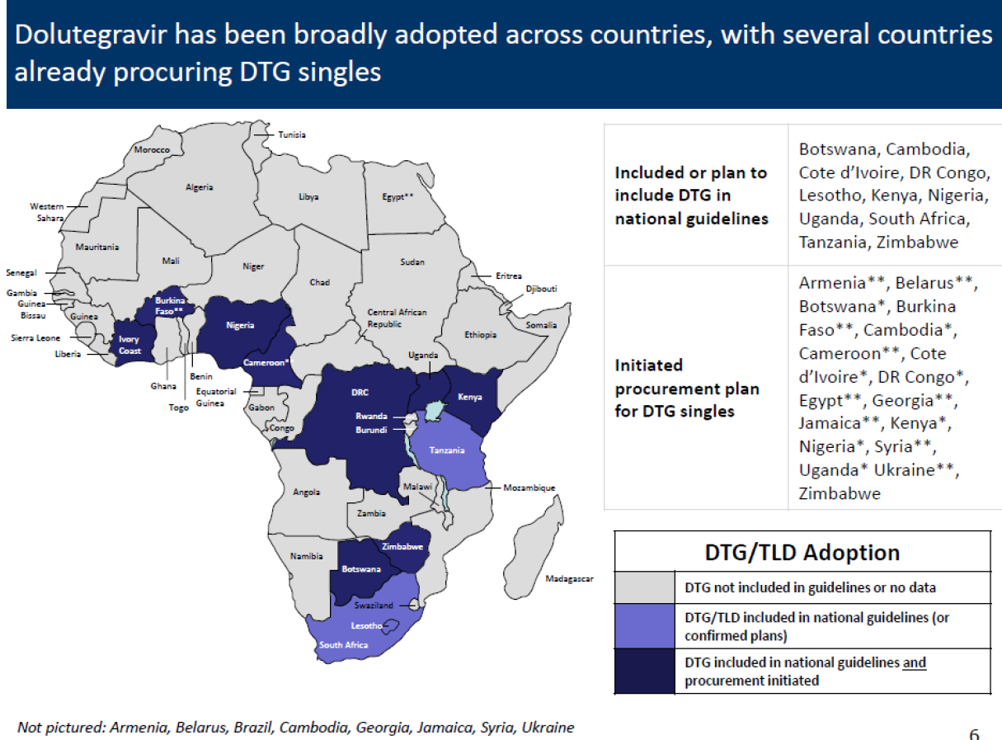
Slide courtesy PEPFAR

Slide 16
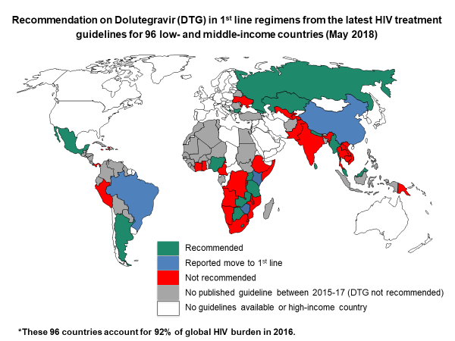
Dynamic Low Middle Income 1st Line DTG policy

Slide 17

Safety signal

Slide 18
Safety signal: real or artefact?
Keep working the problem
  Listen to women
  Case series (interview the mothers)
  Improve surveillance
  Cohorts and other observational studies
  Calculate benefits vs risks of not taking TLD for mother, fetus, partners, and other children
  Monitor guidelines and registration progress
  Monitor transition progress
Put information in public domain
Listen to women

Slide 19
Upsides and downsides of not taking TLD
Upsides
  Avoid undefined but possible small risk of neural tube defect
Downsides
  Lower efficacy with possible illness and death of mother and fetus (and if mother dies or is ill then risk for other children)
  Longer time to suppression (illness, transmission to partner)
  Lower barrier to resistance and failure (and efficacy in face of resistance)
  Higher costs for patients and community
  Potential public health downside if fewer people can be treated and/or if resistance grows
Complex calculus that is heavily influenced by culturally driven values

Slide 20
Recommendations
Continue the TLD transition—in the end it is likely that soon
most people will be on it
Urgently address the policy and registration lag
Use economies of scale to further lower prices ($75 is ceiling)
Use TLD to simplify high quality service delivery to
reach 95-95-95
Use available data to calculate upsides and downsides of
not taking TLD for women who may become pregnant
Use wide decision frame regarding TLD risks and benefits
  to drive guidelines and individual choice

Slide 21

5e mousquetaire
5e mousquetaire
Thank you

